Slide 1
Azure Monitoring Deep Dive Updated 5 Feb 2020

Slide 2
AMDD > Agenda
Big picture
Basics
Metrics
Alerts
Q&A
Logs

Slide 3

AMDD > Big Picture

Slide 4
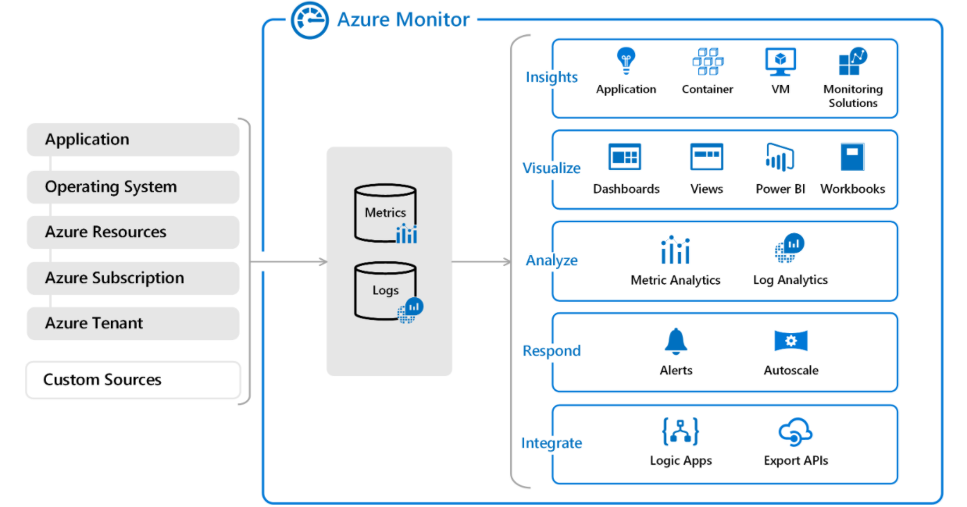
AMDD > Big Picture > Azure Monitor
Azure Monitor
data sources
Azure Monitor services
Azure Monitor Log Analytics workspace

Slide 5

AMDD > Big Picture > Application Insights
Solutions instrumented via Application Insights SDK(s)
Integration Services
Azure Application Insights Resource in Azure

Slide 6
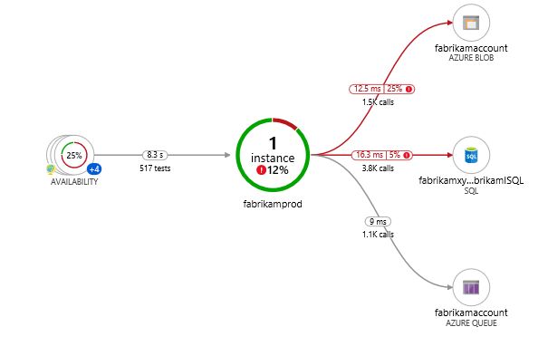
AMDD > Big Picture > Application Insights > Application Maps
Helps identity performance bottlenecks or failure hotspots across all components in a distributed application.
Each node on the map represents an application component or its dependencies.
Components are independently deployable parts of your distributed/microservices application.
Components run on any number of server/role/container instances.
Components can be separate Application Insights instrumentation keys.

Slide 7

AMDD > Big Picture > Demo

Slide 8

Azure Monitor > Basics

Slide 9

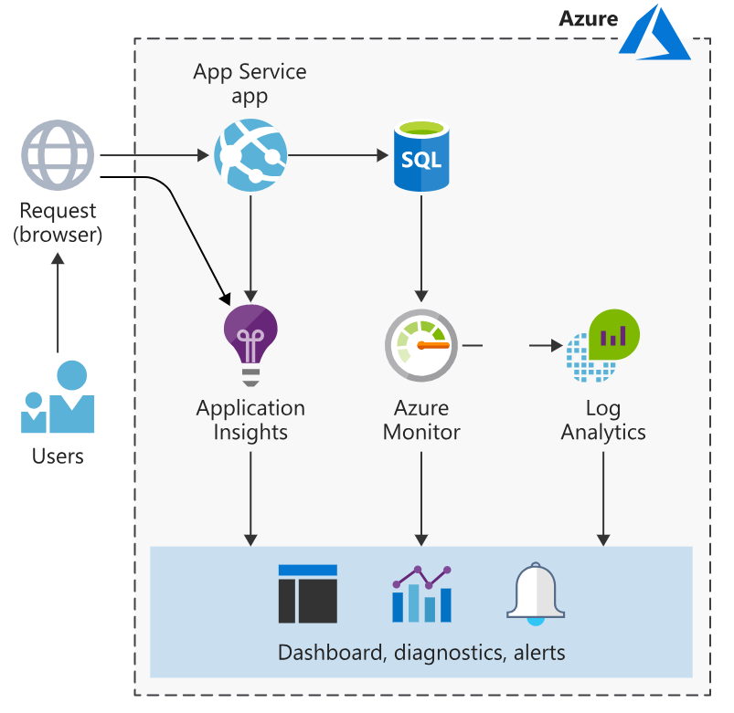
Azure Monitor > Basics > Taxonomy
Agents - are programs designed to ship metrics & logs to Azure Monitor.
Data sources – are processes sending metric & log data via agents and/or SDKs.
Resources – are services created in Azure that are observed by Azure Monitor.
Workspaces – are storage units for metrics & logs.
SDKs – are libraries used to control instrument of your distributed tracing.
Services – Integration services provided by Azure Monitor.

Slide 10
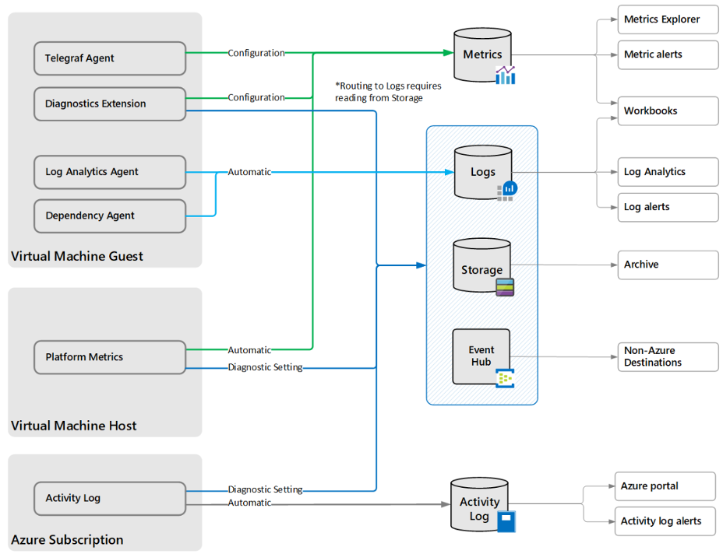
Azure Monitor > Basics > Agents
Log Analytics Agent - targets OS & VMs in Azure, other cloud providers, and on-premises machines.
Azure Diagnostics Extension – targets OS & workloads of VMs and other compute resources.
Telegraf Agent - targets Linux computers.
Azure Monitor Agent – replaces the above from 2024+
Dependency Agent - targets processes running on the machine and external process dependencies.

Slide 11
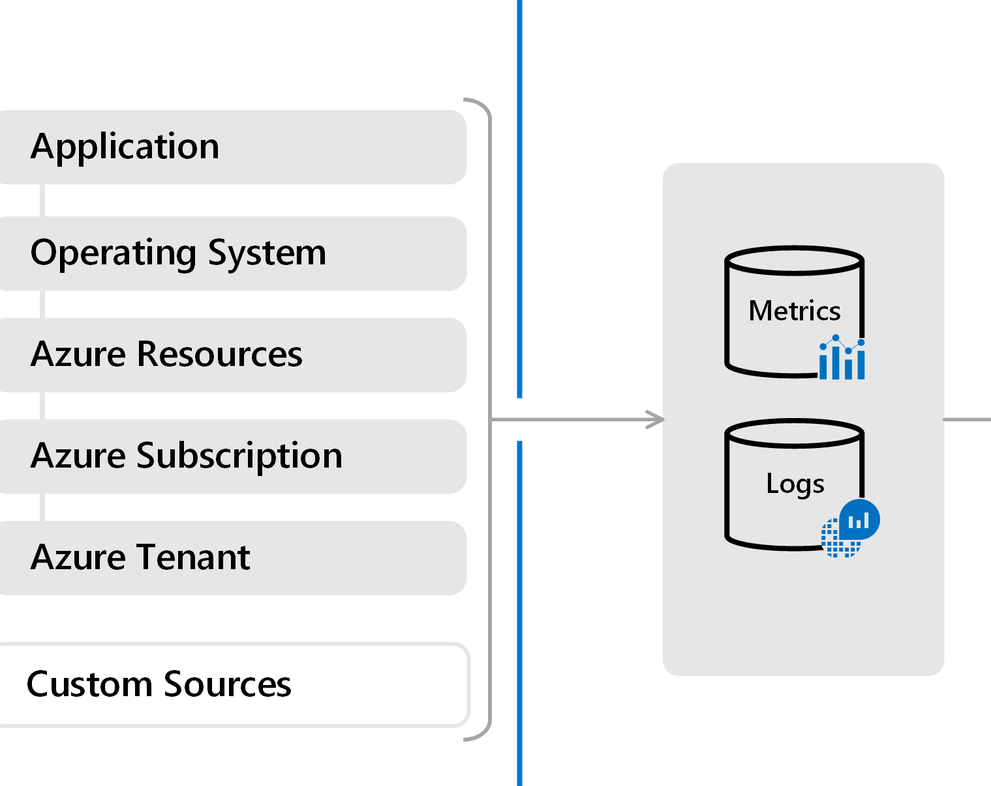
Azure Monitor > Basics > Data Sources (tiers)
Application – Data from SDK-enabled processes.
OS – Data from OSs orchestrated by Azure.
Resource - Data about the operation and performance of Azure resources (SaaS/PaaS).
Subscription - Data related to the health and management of cross-resource services, e.g. Resource Manager and Service Health.
Tenant - Data about the operation of tenant-level Azure services, e.g. Azure AD.
Custom – Everything else.

Slide 12
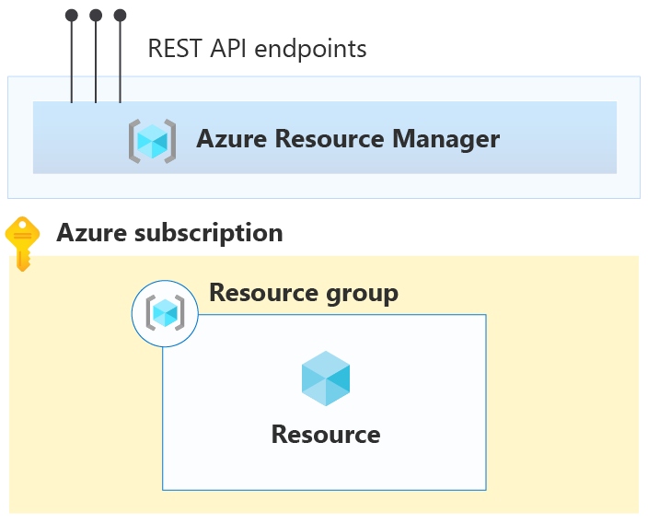
Azure Monitor > Basics > Resources
Activity log - Subscription level events that track operations for each Azure resource.
Platform metrics - Numerical values that are automatically collected at regular intervals and describe some aspect of a resource at a particular time.
Resource logs - Provide insight into operations that were performed by an Azure resource, for example getting a secret from a Key Vault or making a request to a database.

Slide 13
Azure Monitor > Basics > Workspaces
Are the logical storage unit where data is collected and stored.
Contain two databases: logs & metrics.
Supports extensible dashboards & widget configurations to visualize data.
Uses Kusto Query Language (KQL) to query databases.

Slide 14
Azure Monitor > Basics > SDKs
ASP.NET
ASP.NET Core
NodeJS
JavaScript
App Center (mobile SDK)

Slide 15
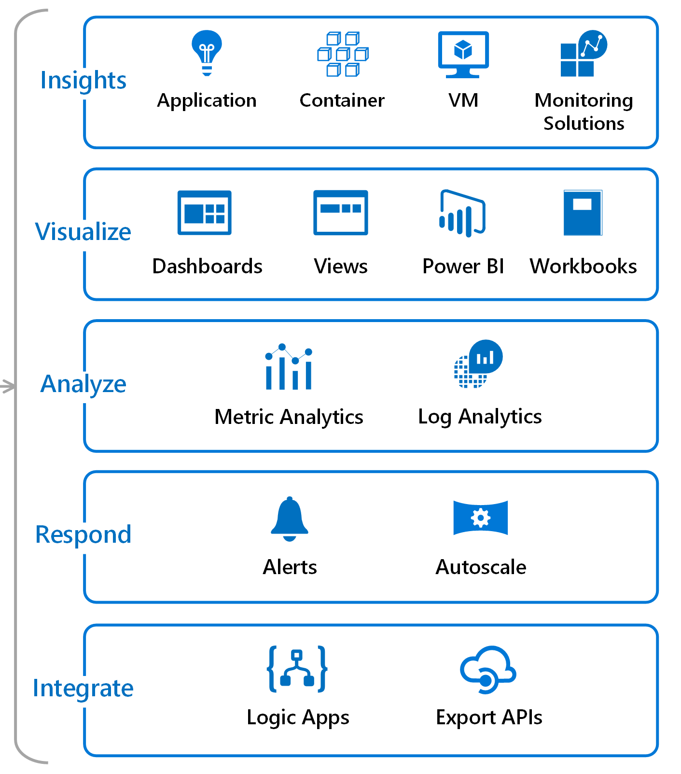
Azure Monitor > Basics > Services
Insights - services responsible for capturing application logs & metrics.
Visualize - services used to visualize data.
Analyze – services available for analyzing data.
Respond – services focused on responding to patterns identified in the data.
Integrate – services related to integrating Azure Monitor with third parties.

Slide 16

Azure Monitor > Basics > Hands-on

Slide 17

Azure Monitor > Basics > Code Kata #1
Notes:
https://www.serverless360.com/blog/azure-log-analytics-workspace (setup workspace)
Create a dashboard with standard CPU metrics
Create simple .net app w. instrumentation

Slide 18

Azure Monitor > Basics > Q/A

Slide 19
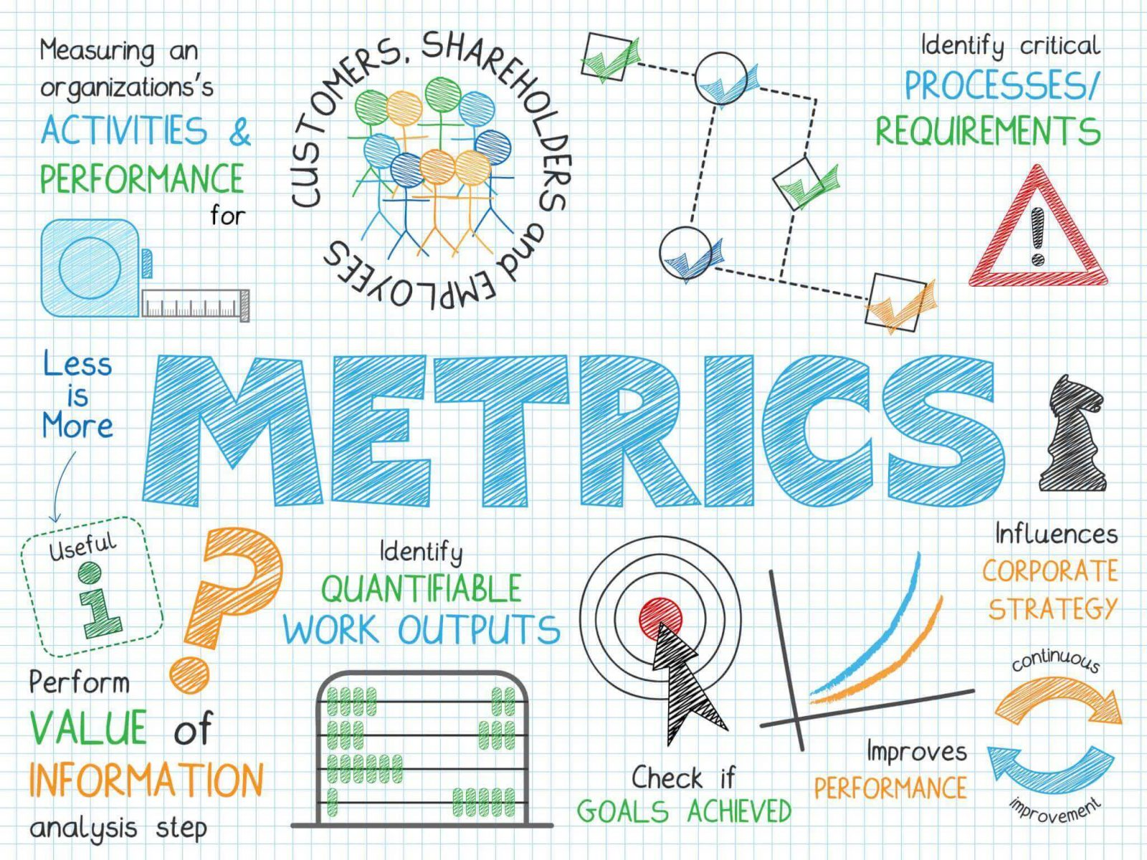
Azure Monitor > Metrics

Slide 20
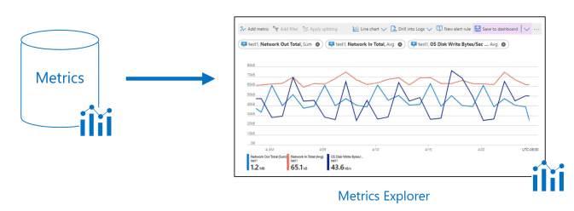
Azure Monitor > Metrics > Metric Explorer
Provides an easy-to-use editor for querying metrics data.
Allows plotting charts, visually correlating trends, and investigating spikes & dips in metrics values.
Support filtering and splitting which are powerful diagnostic tools for metrics with dimensions.

Slide 21
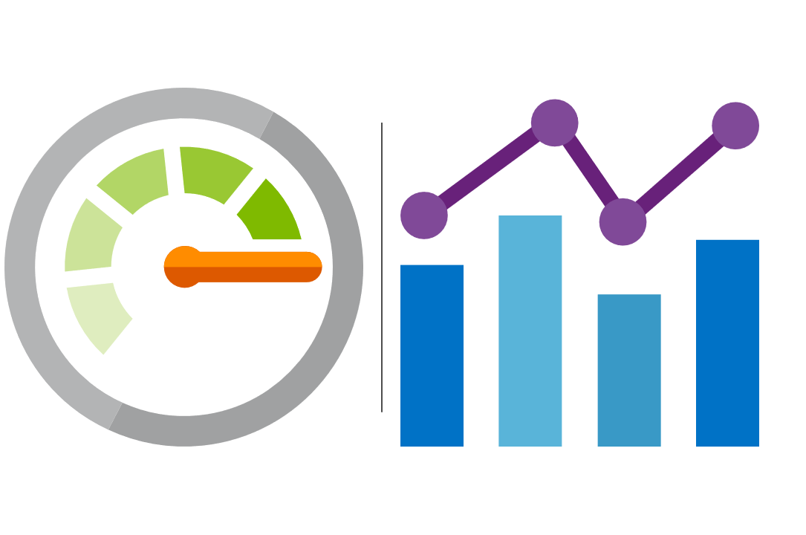
Azure Monitor > Metrics > Guidelines
Must be simple, objective and hard to misinterpret.
Collection should be automated and non-intrusive.
Contributes to quality assessment in the software development lifecycle.
Support RED-metrics when possible (Request Rate, Request Errors & Request Duration).

Slide 22
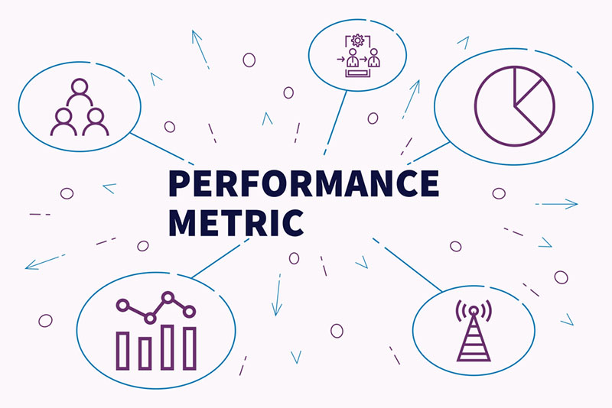
Azure Monitor > Metrics > Types
Log-based (Standard) - available by default in Azure Monitor.
Log-based (Custom) - created on demand via Application Insight SDKs or REST API.
Multi-dimensional - dimensions are name/value pairs that carry additional data to describe the metric value.
Pre-aggregated - are stored as pre-aggregated time series, and only with key dimensions, which makes them superior at query time.

Slide 23
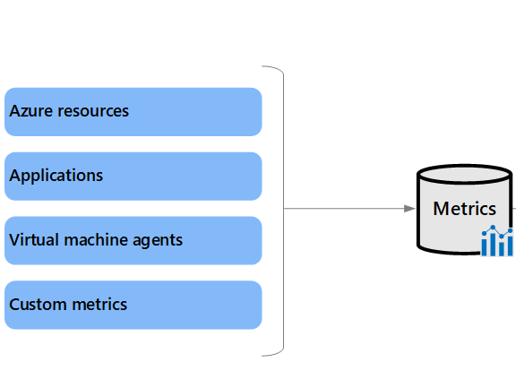
Azure Monitor > Metrics > Source
Azure resources - platform metrics provide visibility into resource health and performance.
Applications Insights - help you detect performance issues and track trends.
Virtual machine agents - collect metrics from the guest operating system of a virtual machine.
Custom metrics - extends the standard metrics that are automatically available in Azure Monitor.

Slide 24
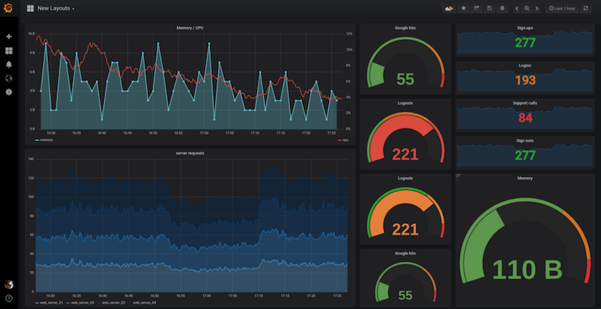
Azure Monitor > Metrics > Quotas and limits
Total active time series in a subscription (across all regions): 50,000
Dimension keys per metric: 10
String length for metric namespaces, metric names, dimension keys, and dimension values: 256 characters

Slide 25
Azure Monitor > Metrics > Hands-on

Slide 26
Azure Monitor > Metrics > Code Kata #2
Notes:
Create custom metrics in .NET app via NuGet package
Setup a simple alert in Azure Monitor based on metrics to send email

Slide 27
Azure Monitor > Metrics > Q/A

Slide 28

Azure Monitor > Logs

Slide 29
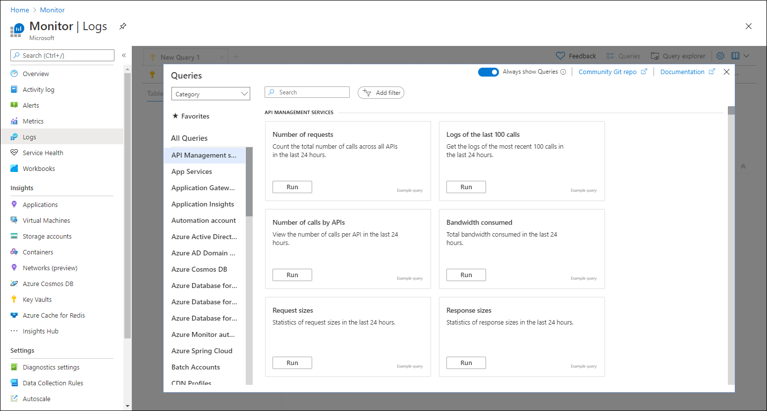
Azure Monitor > Logs > Log Analytics
Queries can be saved and shared for others to use
Log Analytics enables us to write queries used to fetch data from Azure Monitor Logs
WYSIWYG tooling makes it easy to run and edit existing queries

Slide 30
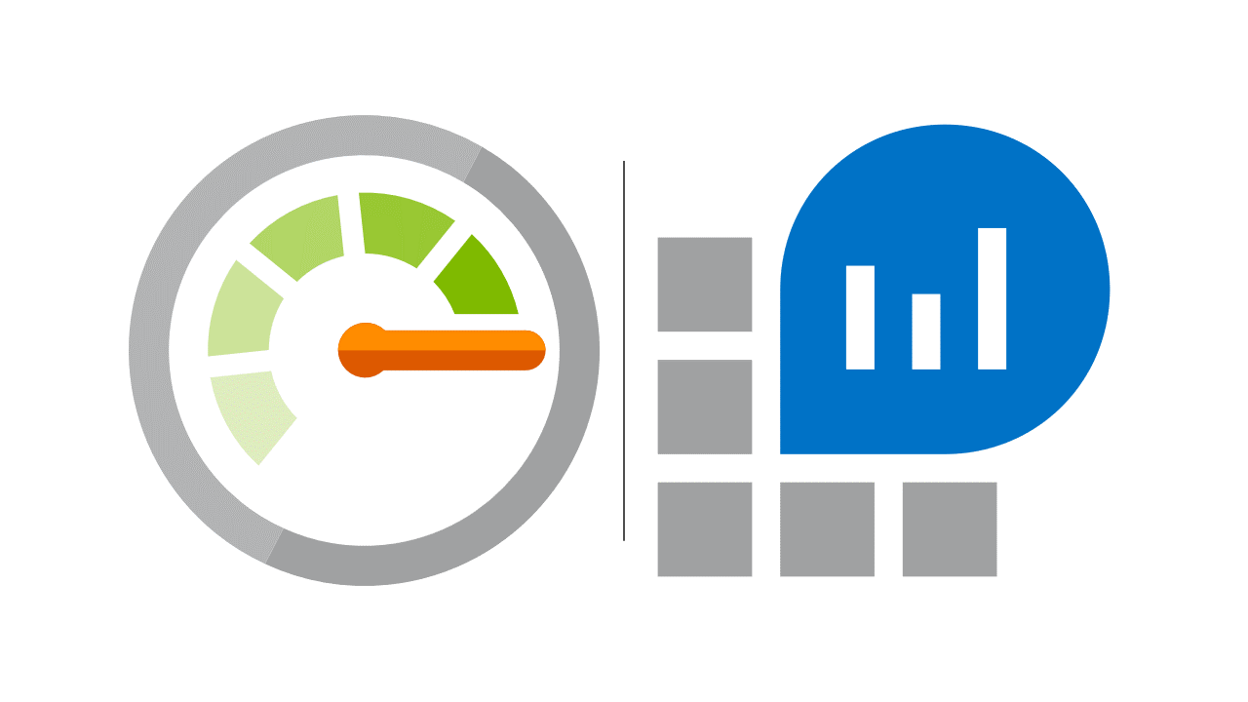
Azure Monitor > Logs > Guidelines
Use Serilog.
Use an Application Insights Sink to ship logs to the cloud.
Use a Console Sink to ship logs to stdout.
Use a File Sink to ship logs to the local disk.
Use a JSON data format for logs.
Remember your log levels & types.

Slide 31
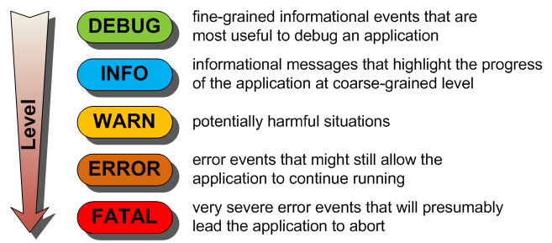
Azure Monitor > Logs > Log Levels
Trace - Contain the most detailed messages.
Debug - For debugging and development.
Information - Tracks the general flow of the app.
Warning - For abnormal or unexpected events.
Error - For errors and exceptions that cannot be handled.
Critical - For failures that require immediate attention.
None - Specifies that a logging category shouldn't write messages.

Slide 32
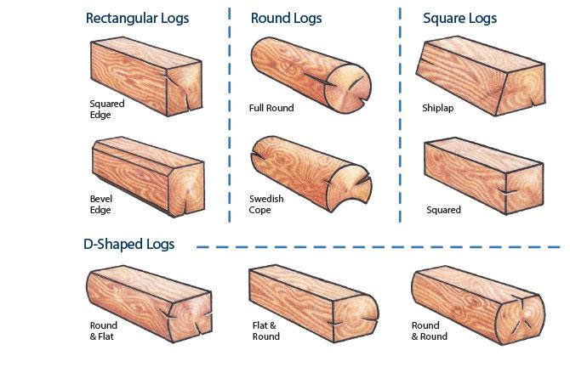
Azure Monitor > Logs > Log Types
Administrative - These events are primarily for end users, administrators, and support to indicate a problem and a well-defined solution that an administrator can act on.
Analytical - Events in an analytic event log are published in high volume.
Debug - Events in a debug type event log are used solely by developers to diagnose a problem for debugging.
Operational - Events in an operational type event log are used for analyzing and diagnosing a problem or occurrence.

Slide 33
Azure Monitor > Logs > Hands-on

Slide 34
Azure Monitor > Logs > Code Kata #3
Notes:
Configure ApplicationInsights Serilog sink
Create a few trace logs
Setup a dashboard to visualize new trace logs

Slide 35
Azure Monitor > Logs > Q/A

Slide 36

Azure Monitor > Alerts

Slide 37

Azure Monitor > Alert > Types
Metric alerts - work on top of multi-dimensional metrics. These metrics could be platform metrics, custom metrics, popular logs from Azure Monitor converted to metrics and Application Insights metrics.
Log alerts - allow users to use a Log Analytics query to evaluate resources logs every set frequency, and fire an alert based on the results.
Activity log alerts - alerts that activate when a new activity log event occurs that matches the conditions specified in the alert.

Slide 38
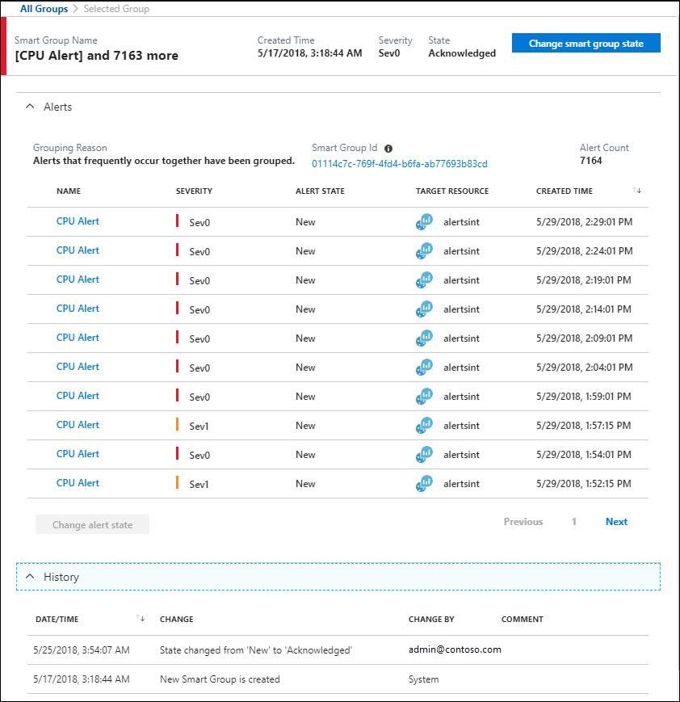
Azure Monitor > Alerts > Smart Groups
Automatically created by using machine learning algorithms.
Combine related alerts that represent a single issue.
Algorithm adds alerts to a new smart group or an existing smart group based on historical patterns, similar properties, and similar structure.
Algorithm only considers alerts from the same monitor service within a subscription.
Smart groups can reduce up to 99% of alert noise through this consolidation.

Slide 39
Azure Monitor > Alerts > Hands-on

Slide 40
Azure Monitor > Alerts > Code Kata #3
Notes:
Setup some advanced alerts in Azure Monitor based on metrics

Slide 41
Azure Monitor > Alerts > Q/A

Slide 42
Azure Monitor > Feedback
https://forms.office.com/Pages/ResponsePage.aspx?id=ZpSpcwWtIUKfkOcUKqL2wTFclz-gNvpNq3THAj1j3ZxUODk1TjlEWVNJNzUxNjAwTFhGQkQ2VkNTWi4u

Slide 43
Azure Monitor > Literature
https://docs.microsoft.com/en-us/azure/azure-monitor/overview
https://docs.microsoft.com/en-us/learn/modules/azure-monitor/
https://docs.microsoft.com/en-us/learn/modules/design-solution-to-log-monitor-azure-resources/
https://docs.microsoft.com/en-us/learn/modules/analyze-infrastructure-with-azure-monitor-logs/
https://docs.microsoft.com/en-us/learn/modules/monitor-app-performance/
https://docs.microsoft.com/en-us/learn/modules/microservices-logging-aspnet-core/

